Slide 1
UNIVERSITY INSTITUTE OF COMPUTING
Master of Computer Applications
Seminar Presentation
<M_20CAR-719>
<Real Estate Website>
Student Name: Prince Kumar
UID:20MCA1082
Section/Group:20MCA1/A
Supervisor Name: Anand Kumar Shukla
Employee Code:
Designation:
Minor Project Presentation
DISCOVER . LEARN . EMPOWER

Slide 2
What is Real Estate:
Real estate is the land along with any permanent improvements attached to the land, whether natural or man-made—including water, trees, minerals, buildings, homes, fences, and bridges. Real estate is a form of real property. It differs from personal property, which are things not permanently attached to the land, such as vehicles, boats, jewelry, furniture, and farm equipment.

Slide 3
What is Real Estate Website:
A platform which growing a Real Estate business on Digital Platform is called a Real Estate Website. It helps to customer find his Dream Home easily on a simple friendly platform.

Slide 4
My Project:- RealHomes
It helps to find Dream home.
It is a user friendly platform.
You can find easily a Property for rent and buy.
You can list a property which you want to sell.
Our agents helps you to find Dream Home.

Slide 5
Technology Used:
WordPress
WordPress Plug-In’s
Xampp
Mysql

Slide 6
WordPress:
Basically I am using Word Press to Built the site. Word Press is a free, open-source website creation platform. On a more technical level, Word Press is a content management system (CMS) written in PHP that uses a My-SQL database. In non-geek speak; Word Press is the easiest and most powerful blogging and website builder in existence today.
Word Press is an excellent website platform for a variety of websites. From blogging to e-commerce to business and portfolio websites, Word Press is a versatile CMS. Designed with usability and flexibility in mind, Word Press is a great solution for both large and small websites.

Slide 7
WordPress Features:
As a website building platform and CMS, Word Press boasts an impressive feature set. Here are just a few of the many features of Word Press.
SEO – Search Engine Optimization (SEO) begins at a technical level and Word Press delivers an exceptional code base for SEO. SEO allows your website’s content to be found via common search engines such as Google or Bing. Check out these free Word press SEO training videos to learn more.
Speed – Word Press is a lean website framework that is constantly striving to remove code “bloat” that slows down the loading speed of a website.
Mobile-friendly – Most Word Press themes are now mobile-friendly or responsive out-of-the-box.
Media file library – Word Press includes a built-in media library where you can upload and embed media files such as images or videos into your pages or posts. You can even perform basic edits to your images within Word Press.

Slide 8
Easy-to-use user interface – Word Press is very easy to use with no complicated settings. If you can use a Word Press processor, you can use Word Press. Word Press also has a focus on accessibility.
Custom menus – Word Press makes it easy to create navigation menus with links to your pages or custom links.
Built-in blog – Adding a blog to your website is as simple as publishing a post.
New in Word Press 5.0: The Word Press Block Editor – Word Press 5.0 introduced the new Block Editor, also known as the Gutenberg Word Press Editor. The new editor transforms the way you edit Word Press pages and posts. Now you can design and arrange your content with a more flexible “drag and drop” approach

Slide 9
WordPress Plug-In’s:
Word-Press Plug-in are PHP scripts that extend the functionality of Word Press. They enhance the features of Word-Press or add entirely new features to your site. Plug-in’s are often developed by volunteers and are usually free to the public. Plug-in’s are available via the Word-Press Plug-in Directory. Although plug-in you find here are thoroughly tested and considered safe to use, they are of varying quality and are often works in progress.

Slide 10
Plug-In’s Used:
Easy Real Estate | Provides real estate functionality for RealHomes theme.
Elementor | The Elementor Website Builder has it all: drag and drop page builder, pixel perfect design, mobile responsive editing, and more. Get started now!
Quick and Easy FAQs | A quick and easy way to add FAQs to your site.
RealHomes Demo Import | Import RealHomes demo contents with one click.
RealHomes Elementor Addon | Provides RealHomes based Elementor widgets.

Slide 11
Xampp:
it is a software distribution which provides the Apache web server, My SQL database (actually Maria DB), Php and Perl (as command-line executables and Apache modules) all in one package. It is available for Windows, MAC and Linux systems. No configuration is necessary to integrate Php with My SQL.
It is a great fit for this course and provides a relatively painless installation and way to manage the configuration changes. Also provided is PhpMyadmin which gives a GUI tool for managing your MyS-QL databases.
I would highly recommend installing this for Windows or MAC. It doesn't exclude you from other competing software installations; it just gives an easy way to get going. For Ubuntu Linux systems, I still would recommend installing Apache/MySQL/Php/PhpMyadmin through Ubuntu packages.

Slide 12
Components of Xampp which we need:
Apache: Apache is the actual web server application that processes and delivers web content to a computer. Apache is the most popular web server online, powering nearly 54% of all websites.
My-SQL: Every web application, howsoever simple or complicated, requires a database for storing collected data. My-SQL, which is open source, is the world’s most popular database management system. It powers everything from hobbyist websites to professional platforms like Word Press. You can learn how to master PHP with this free My-SQL database for beginner’s course.
Note:-
We have to on those two components on Xampp for working on local host.
We have to install word press on local host.

Slide 13
For installing the word press on local hot steps are:
Download XAMPP
Install & Run the XAMPP on Your PC
Download Word Press Latest Version
Extract the all files into htdocs folder made by xampp in drive.
Create a Database using phpmyadmin
Install Word Press on Local host

Slide 14
MY-SQL
Every web application, howsoever simple or complicated, requires a database for storing collected data. My-SQL, which is open source, is the world’s most popular database management system. It powers everything from hobbyist websites to professional platforms like Word Press. You can learn how to master PHP with this free My-SQL database for beginner’s course.

Slide 15
Features:
It helps to find Dream home.
It is a user friendly platform.
You can find easily a Property for rent and buy.
You can list a property which you want to sell.
Our agents helps you to find Dream Home.

Slide 16
Objectives:
The foremost objective of this project was to give a different visualization styles to the Real Estate Website which has more features, attractive animations and all together a new look in contrast to the already existing websites. Usually in a real estate website, the property search page consist of traditional search style i.e. a set of textboxes / drop-downs to select a particular county or MLS# for the property to search along with other web controls to specify the number of beds / baths or any additional features they are looking in the property. In contrast, this website provides altogether a new visualization of the search page.

Slide 17
Scope:
The scope of my project “Real Estate Web Application” is to enable the buyers to search for property listings online. The motive of developing this Application is to design a feature rich search engine which can make the search of commercial land/properties an easy task.
Goal is to gain a good knowledge of the complete life cycle of the project development starting from the Requirement Gathering Phase to the Testing Phase

Slide 18
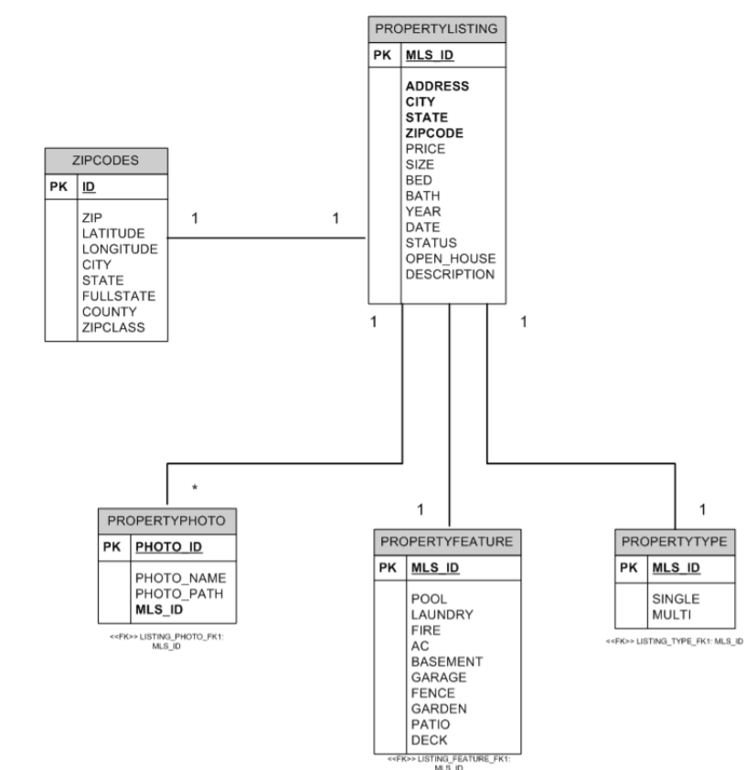
ER-Diagram

Slide 19
Testing:
Performance of a web-application can be tested done by applying the Load and Stress Testing on it. Load testing is subjecting the application to a statistically representative load. This testing is done in support of the application reliability testing and in performance testing. In performance testing, the load is varied from minimum (zero) to the maximum level the application can handle without application-specific excessive delay. In this testing the realistic workloads are characterized, simulated and submitted to the system under test. Load Testing verifies the acceptability of the target-of-test's performance behavior under varying operational conditions (such as number of users/threads, number of loop counts, etc.) while the configuration remains constant. While the Stress Testing verifies the acceptability of the target-of-test's performance behavior when abnormal or extreme conditions are encountered, such as diminished resources or extremely high number of users. Extreme loads are used in load stress testing - to find the breaking point and bottlenecks of tested system. In load stress testing we have tried breaking the application by an extreme load and expose bugs that are likely to appear under stress, such as data corruption, buffer overflows, large number of users, etc. 27 Load analysis needs to proceed by having a special purpose browser act like a human user. This assures that the performance checking experiment indicates true performance - not performance on simulated but unrealistic conditions. The testing tools try to perform Load Simulation to re-create a realistic scenario and so the results obtained assures that they can be used to analyze the performance characteristics of the web site under high load condition

Slide 20
Conclusion:
This Real Estate Web Application is a typical Word press site. It uses Drag and drop function environment. The buyer performs a search for the property listings by putting either Zip code/City/State or MLS# in the search textbox. The business logic tier communicates with the database tier requesting the results of the query sent by it. The results obtained by the database are displayed on the data grid, by refreshing the grid rather than refreshing the entire web page. Efficiency of the application is improved by the use of web methods that help in separating Application Tier from the Presentation Tier. The performance of this application is evaluated by rigorously testing it against various test scenarios. Efficiency and correctness of the application is evaluated with the help of various test cases. Some ways in which this system could be enhanced with additional functionalities are discussed in the section.

Slide 21
Future Extension of Project:
This project is developed as a master’s project and still gives lot of scope for its extension which could be made to the project if it is going to be developed as commercial product. This project just deals with the Home page and Search page to search for property listings, more functionality can be added for searching the agents and offices making it a complete application. The feature of providing Google Maps within this application adds up to 45 the functionality of the website. With the advancement of technology, dynamic maps can be generated using AJAX which can help the buyer locate a particular area where the property is located in the Google Map. Inclusion of all these features would make the application feature rich.

Slide 22
References
What is Real Estate
Real Estate Definition (investopedia.com)
Scope of the project
https://core.ac.uk/download/5165004.pdf
Word press features
https://www.geeksforgeeks.org/introduction-wordpress/
Xampp
https://www.cs.wcupa.edu/rkline/index/xampp
Objectives of the project
https://core.ac.uk/download/5165004.pdf

Slide 23
Mysql:
https://en.wikipedia.org/wiki/mysql

Slide 24
THANK YOU

